Slide 1

The Stories We Live By
A free online course in ecolinguistics
www.storiesweliveby.org.uk
by Arran Stibbe
University of Gloucestershire

Slide 2
Part 4: Metaphor
Notes:
This is Part 4 of the online course Stories we live by. In this part we will be exploring metaphor

Slide 3
Social Cognition |  | Linguistic Manifestation
Type | Explanation | What to look for
ideology | a story of how the world is and should be which is shared by members of a group | discourses, i.e., clusters of linguistic features characteristically used by the group
framing | a story that uses a packet of knowledge about an area of life (a frame) to structure another area of life | trigger words which bring a frame to mind
metaphor (a type of framing) | a story that uses a frame to structure a distinct and clearly different area of life | trigger words which bring a specific and distinct frame to mind
evaluation | a story about whether an area of life is good or bad | appraisal patterns, i.e., patterns of language which represent an area of life positively or negatively
identity | a story about what it means to be a particular kind of person | forms of language which define the characteristics of certain kinds of people
conviction | a story about whether a particular description of the world is true, uncertain or false | facticity patterns, i.e., patterns of linguistic features which represent descriptions of the world as true, uncertain or false
erasure | a story that an area of life is unimportant or unworthy of consideration | patterns of language which fail to represent a particular area of life at all, or which background or distort it
salience | a story that an area of life is important and worthy of consideration | patterns of language which give prominence to an area of life
Notes:
which is the third of the eight types of story we’re looking at in this course.

Slide 4
Metaphor (a type of framing)
A story that uses a frame to structure a distinct and clearly different area of life
Notes:
Metaphor is a type of framing, and I’m defining it here as ‘A story that uses a frame to structure a distinct and clearly different area of life’

Slide 5
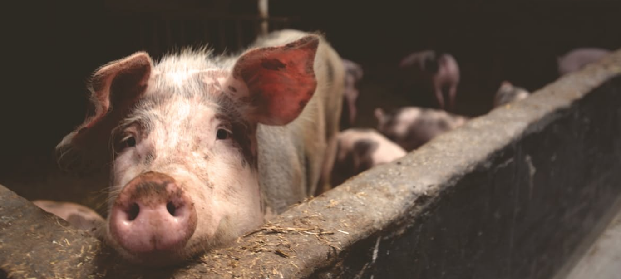
The breeding sow should be thought of as, and treated as, a valuable piece of machinery whose function is to pump out baby pigs like a sausage machine.
(Walls Meat Company manager in Singer 1990, p. 126)
Notes:
We’ll start with this example, which is a rather shocking way of talking about pigs by a manager in the Walls meat company. The metaphor here is clearly ‘pigs are machines’ – if pigs are machines then they don’t have feelings, which justified treating them badly in factory farms. And factory farms are known for both their cruelty and environmental damage. This metaphor was used a long time ago, though, in the 1970s.

Slide 6
Pork Industry Handbook
As long as boars remain structurally sound and are aggressive breeders, fertility is generally maintained.
Adequate boar power is critically essential to take advantage of synchronization of postweaning heat.
Pigs suppress eating and increase water intake during periods of heat stress.
To prevent sow breakdown make sure the lactation ration is properly fortified
(from PIH factsheets 1, 8, 54, and 48 respectively)
Notes:
We just don’t find shocking metaphors like that in the modern pork industry. But still, if we look closely at the kind of language used we can see that the metaphor ‘pigs are machines’ still exists in a more subtle way. If we look at these quotes from the Pork Industry Handbook we can see words like ‘structurally’, ‘power’, ‘intake’, and ‘breakdown’, which are taken from the world of machines, and used to talk about living pgs.

Slide 7
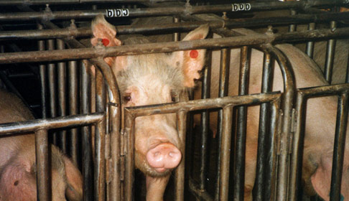
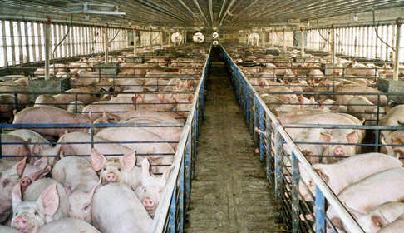

Slide 8
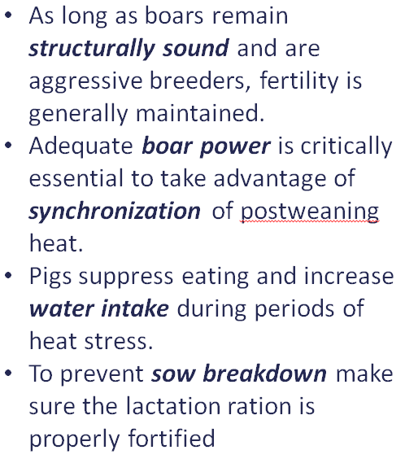



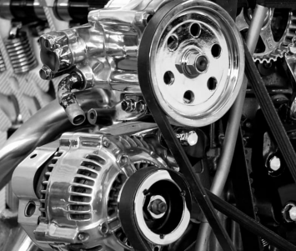
Stories influence how we:
THINK TALK and ACT
Metaphor
Language
Impact
a story which uses a very different frame to structure an area of life
trigger words which activate a frame
impact on the world
PIGS ARE MACHINES
Notes:
We can say that the metaphor ‘pigs are machines’ exists in minds of factory farm managers, manifests itself as particular forms of language use, and has an impact on the world, justifying a form of animal farming that is both cruel and environmentally destructive.

Slide 9
The difference between metaphor and literal framing
Notes:
So what is the difference between metaphor and literal framing

Slide 10
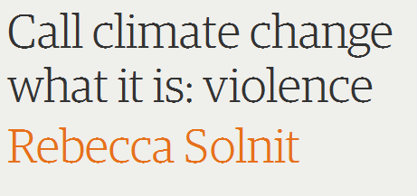
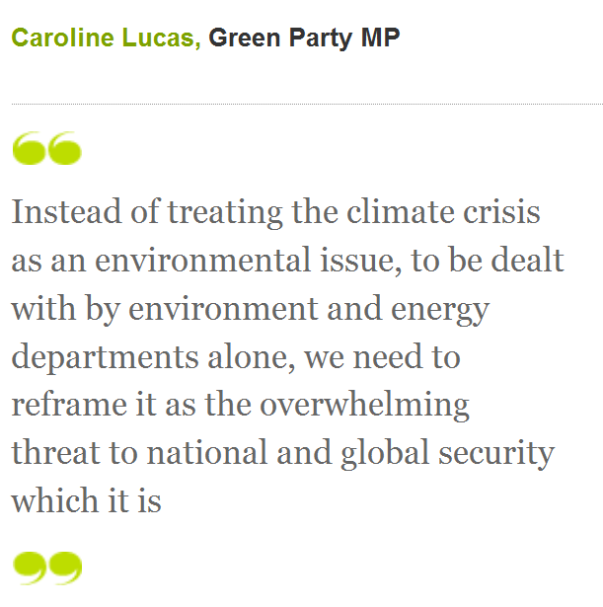
FRAMING
climate change is violence
These are literal framings, not metaphors
climate change is a security threat
Notes:
Well when we looked at the climate change framings, notice that Rebecca Solnit uses the expression ‘what it is’ (call climate change what it is, violence). And Caroline Lucas uses the expression ‘which it is’ (we need to reframe climate change as the threat to national security which it is). So they are arguing that climate change literally is violence or a security threat…

Slide 11
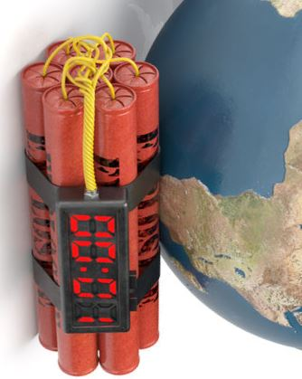
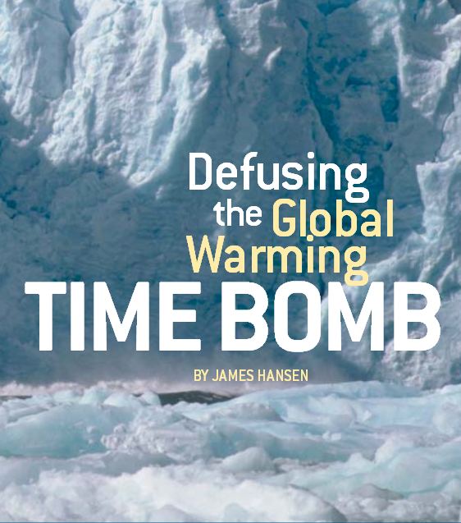
METAPHOR
James Hansen
Hansen 2004
climate change is a time bomb
Notes:
On the other hand, we couldn’t say that ‘call climate change what it is: a time bomb’ because it clearly is not literally a time bomb. A time bomb is something quite different. So ‘climate change is a time bomb’ is a metaphorical framing, used by climate scientist James Hansen in a paper he wrote in the journal Nature.

Slide 12
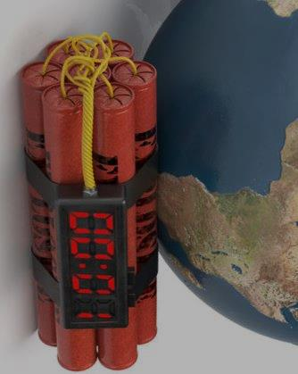
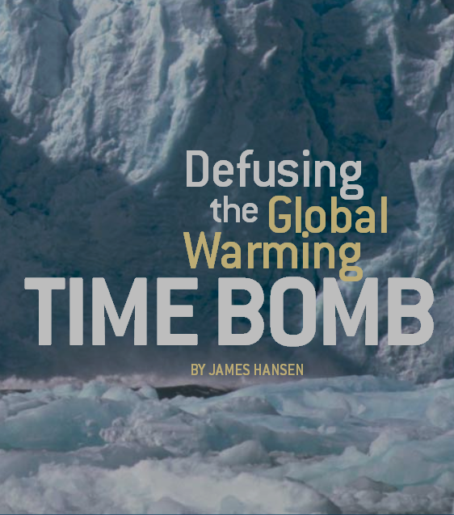
SOURCE FRAME
TARGET DOMAIN
TIME BOMB
Bomb
Victims
Defusing the bomb
Explosion
Victims
CLIMATE CHANGE
Climate change
People in poor countries
keep carbon emissions level
coastlines will be inundated
large proportion of world’s people
structure
Limited time to defuse the bomb before it explodes harming the victims
entailment
There is limited time to reduce carbon emissions before coastlines are inundated harming a large proportion of the world’s people
mapping
Notes:
If we analyse this in detail we can see that the source frame, the time bomb, consists of certain elements. With a time bomb you have the bomb, the victim, defusing the bomb, an explosion and victims. In his text, Hansen maps these elements of the source frame to elements of the target domain, which is climate change. So bomb gets mapped to climate change itself, the victims are people in poorer countries, defusing the bomb is keeping carbon emissions level and so on. Put all together the metaphor creates the reasoning pattern that ‘There is limited time to reduce carbon emissions before coastlines are inundated harming a large proportion of the world’s people’. But why couldn’t he just say it like that? Well the time bomb metaphor implies something terribly urgent and terribly harmful, and this image is intended to help encourage people to spring into action. It’s not a perfect metaphor, though, and we could discuss the advantages and disadvantages of this one compared to other metaphors that could be used to describe climate change.

Slide 13
Stories influence how we:
THINK TALK and ACT
Metaphor
Language
Impact
a story which uses a very different frame to structure an area of life
trigger words which activate a frame
impact on the world
climate change is a time bomb

Slide 14
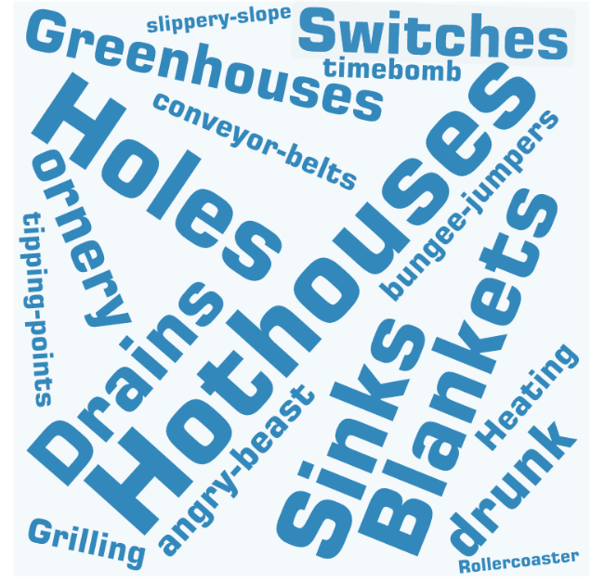

SOURCE FRAME
TARGET DOMAIN
CLIMATE CHANGE
Notes:
And there are a lot of them! Russell found that “There are hothouses and greenhouses, atmospheric blankets and holes, sinks and drains, flipped and flickering switches, conveyor belts…and even bungee jumpers attached to speeding rollercoasters”. All of these need to be investigated from an ecolinguistics perspective: do the stories encourage people to take urgent and suitable action to deal with the threat of climate change?

Slide 15

EXAMPLE
Humankind has not woven the web of life. We are but one thread within it. Whatever we do to the web, we do to ourselves. All things are bound together. All things connect. (attributed to Chief Seattle)
Notes:
One important thing to consider about metaphors is where do they place humans? Are humans part of nature or are we separate from nature? A metaphor like ‘Earth is a Spaceship’ makes humans separate from the Earth, pilots of it rather than part of it. I like this metaphor from Chief Seattle, since it very firmly places humans as part of nature. Why should we save nature or the environment? Because in doing so we are saving ourselves!

Slide 16
End of Part 4

Slide 17
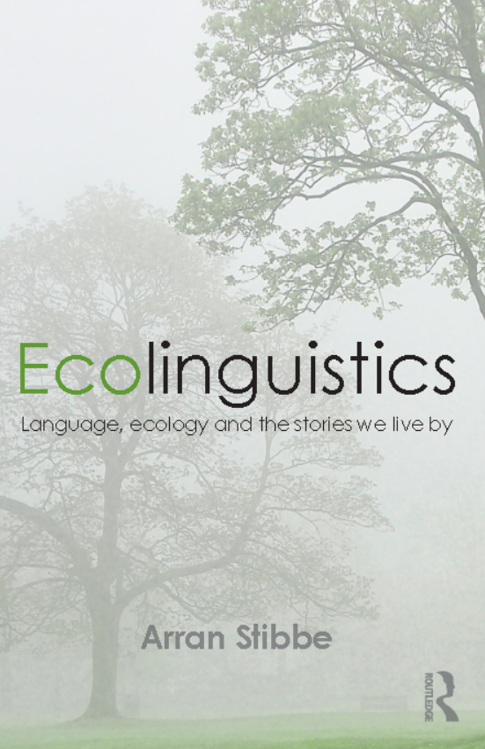
BASED ON
chapter 4 of
Stibbe, Arran (2015) Ecolinguistics: language, ecology and the stories we live by. London: Routledge

Slide 18
CREDITS
Produced by Arran Stibbe, with the assistance of:
Charlotte Dover
Alex James
Meg Shaw
Nicole Walker
and other volunteers from the International Ecolinguistics Association and the University of Gloucestershire.
Filming by Unit One Films, http://unit1films.co.uk

Slide 19
COPYRIGHT
These materials have been produced for public benefit and the producer places no restriction on their subsequent re-use for any purpose. However, copyright of images and quotations used in these materials remains with the original producers.

Slide 20
IMAGES
Head cogs | Copyright: Krisdog / 123RF Stock Photo (www.123rf.com/profile_Krisdog)
World | Copyright: robertsrob / 123RF Stock Photo (www.123rf.com/profile_robertsrob)
Society | Copyright: eobrazy / 123RF Stock Photo (www.123rf.com/profile_eobrazy)
Nature person | Copyright: lenanet / 123RF Stock Photo (www.123rf.com/profile_lenanet)
Time Bomb | Copyright: deniskot / 123RF Stock Photo (www.123rf.com/profile_deniskot)
Factory | Copyright: route55 / 123RF Stock Photo (www.123rf.com/profile_route55)
First image of pig and spider web | Pexels (www.pexels.com)
Second and third images of pig | Farm Sanctuary (permission requested) https://www.farmsanctuary.org/learn/factory-farming/pigs-used-for-pork

Slide 21
REFERENCES
Lucas, Caroline. 2012. In Blight, G. 50 months to save the world. Guardian (online) 1 Oct. https://www.theguardian.com/environment/interactive/2012/oct/01
PIH 2002. Pork industry handbook CD-ROM edition. Lafayette: Purdue University Press.
Solnit, R. 2014. Call climate change what it is: violence. Guardian (online) 7 Apr www.theguardian.com/commentisfree/2014/apr/07
Singer, P., 1990. Animal liberation. 2nd ed. London: Random House.

Slide 22
OTHER IMAGES AND QUOTATIONS
Any quotations and images not mentioned above are reproduced as fair dealing under Section 29(1), Section 30(1) and 30A of the UK 1988 Copyright, Designs and Patents Act, for non-commercial purposes of instruction, review, criticism, parody or pastiche.
Requests for removals of any materials to convenor@ecoling.net

