Slide 1
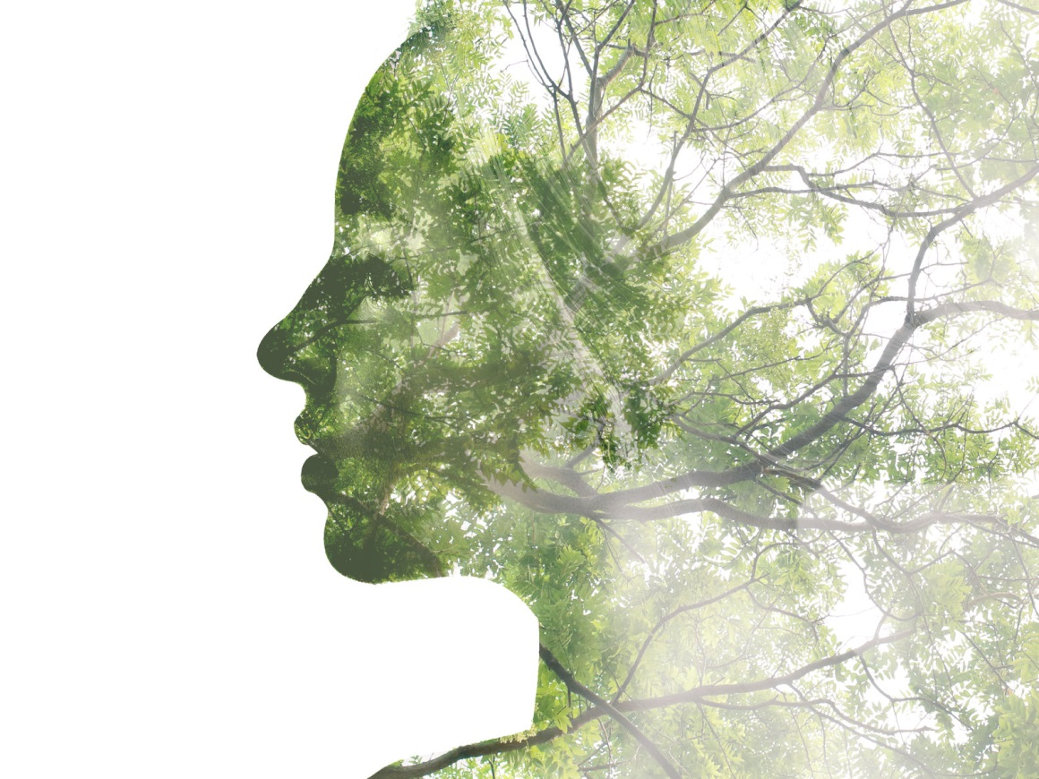
The Stories We Live By
A free online course in ecolinguistics
www.storiesweliveby.org.uk
by Arran Stibbe
University of Gloucestershire

Slide 2
Part 9: Salience
Notes:
This is part 9 of the course Stories we live by

Slide 3
Social Cognition |  | Linguistic Manifestation
Type | Explanation | What to look for
ideology | a story of how the world is and should be which is shared by members of a group | discourses, i.e., clusters of linguistic features characteristically used by the group
framing | a story that uses a packet of knowledge about an area of life (a frame) to structure another area of life | trigger words which bring a frame to mind
metaphor (a type of framing) | a story that uses a frame to structure a distinct and clearly different area of life | trigger words which bring a specific and distinct frame to mind
evaluation | a story about whether an area of life is good or bad | appraisal patterns, i.e., patterns of language which represent an area of life positively or negatively
identity | a story about what it means to be a particular kind of person | forms of language which define the characteristics of certain kinds of people
conviction | a story about whether a particular description of the world is true, uncertain or false | facticity patterns, i.e., patterns of linguistic features which represent descriptions of the world as true, uncertain or false
erasure | a story that an area of life is unimportant or unworthy of consideration | patterns of language which fail to represent a particular area of life at all, or which background or distort it
salience | a story that an area of life is important and worthy of consideration | patterns of language which give prominence to an area of life
Notes:
This part will explore salience, which is the ninth type of story we live by.

Slide 4
Salience
a story that an area of life is important and worthy of consideration
Notes:
Salience can be defined as a story that an area of life is important and worthy of consideration

Slide 5
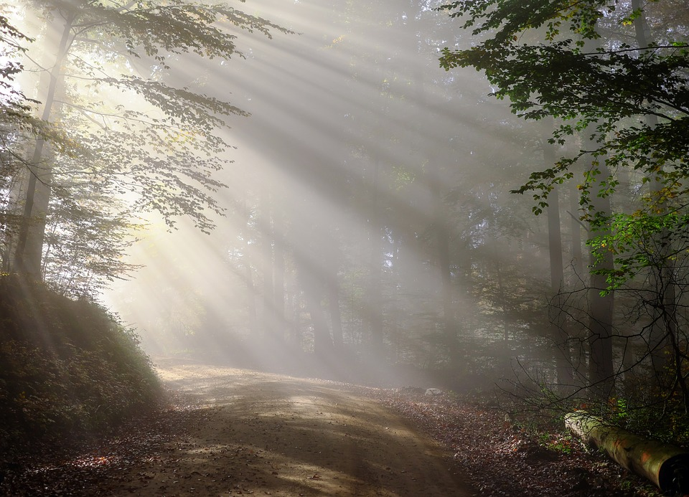
“We can be ethical only in relation to something we can see, feel, understand, love, or otherwise have faith in” (Aldo Leopold)
Notes:
As Aldo Leopold says “We can be ethical only in relation to something we can see, feel, understand, love, or otherwise have faith in”

Slide 6
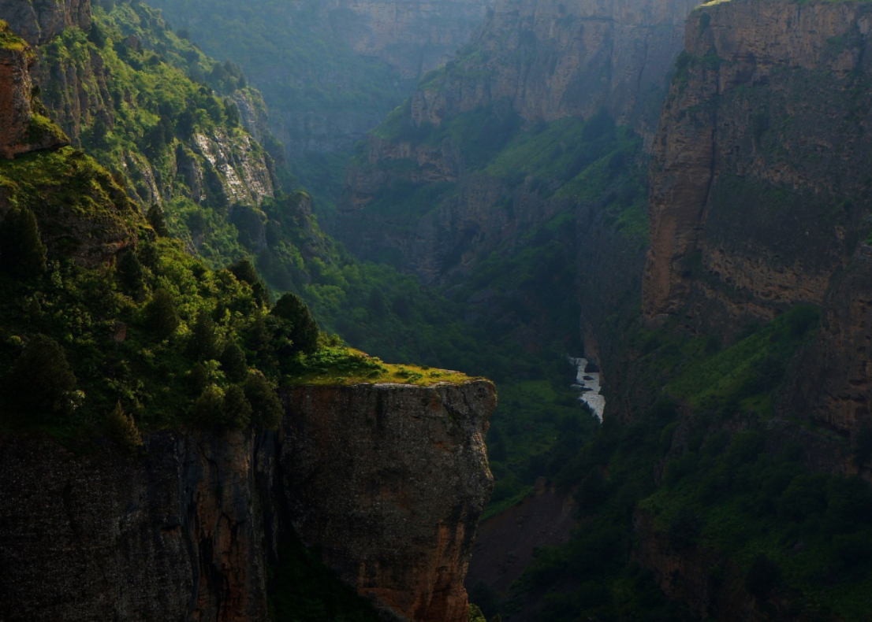
EXAMPLE
CHIEF DAN GEORGE
The time will soon be here when my grandchild will long for the cry of a loon, the flash of a salmon, the whisper of spruce needles, or the screech of an eagle. (Chief Dan George)
ANIMALS AND PLANTS ARE IMPORTANT IN THEMSELVES
Notes:
This example is of a Native American saying, which encourages us to see, feel, and love the natural world. It builds up the salience of nature by using the specific names of species – loon, salmon, spruce, eagle, rather than more abstract terms like fauna or biotic resources. And it appeals to our senses with cry, flash, whisper, screech, creating vivid images.

Slide 7
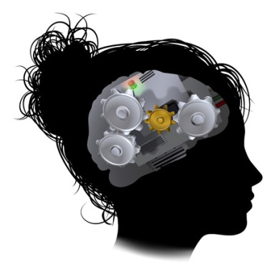
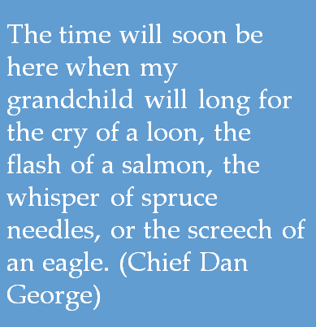
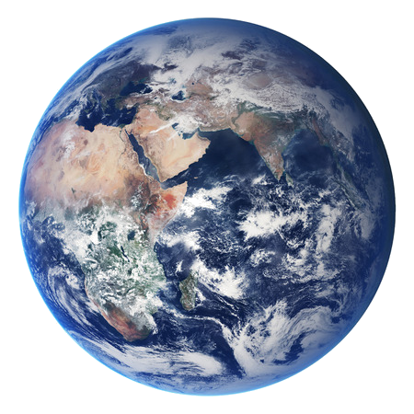
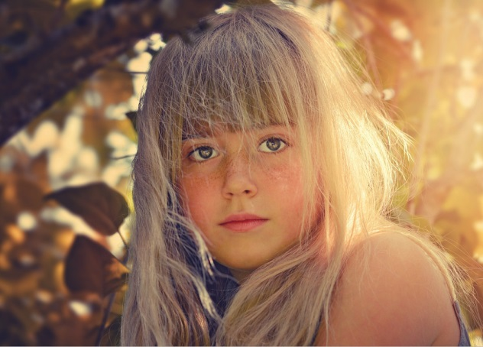

Stories influence how we:
THINK TALK and ACT
Salience
Salience pattern
Impact
ANIMALS AND PLANTS ARE IMPORTANT IN THEMSELVES
Notes:
The story behind this kind of language is that animals and plants are important in themselves, and it could encourage us to care for and protect the natural world.

Slide 8
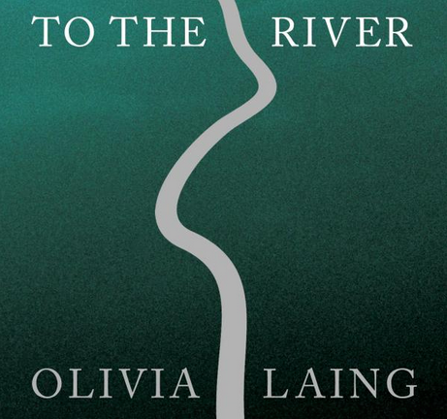
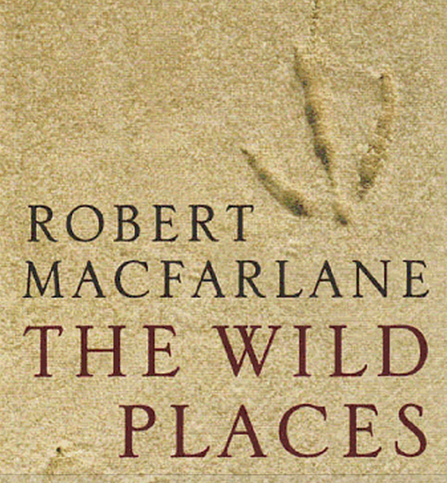
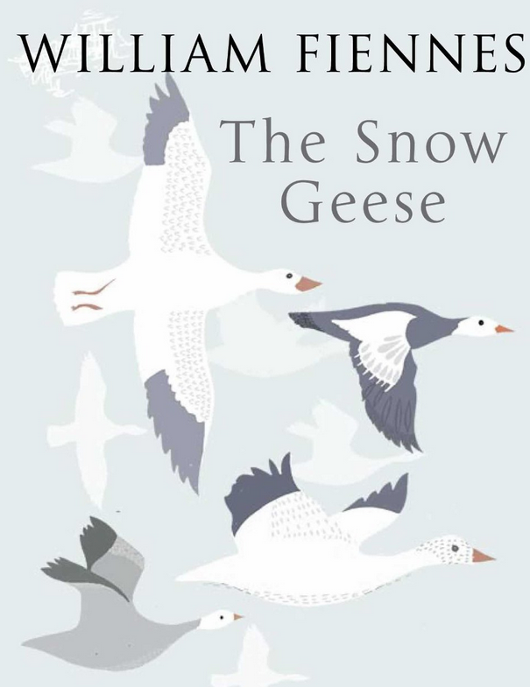

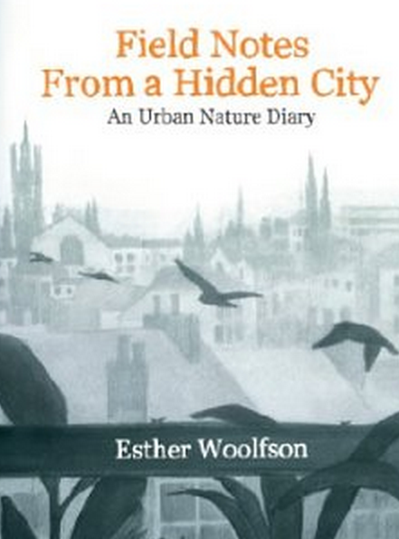
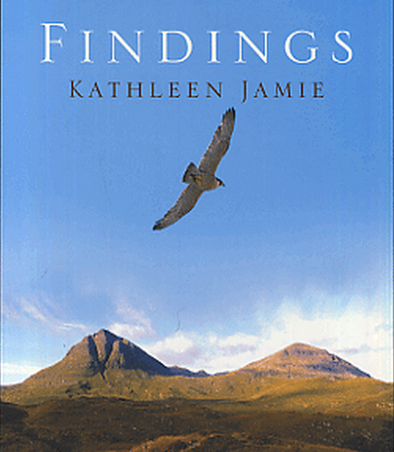
Salience in New Nature Writing
Notes:
One genre which is particularly powerful in giving salience, is New Nature Writing, a contemporary form of British nature writing which shows awareness of environmental and conservation issues.

Slide 9
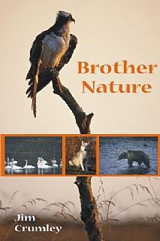
pronouns
She [a grizzly bear] raised her head above the tops of the fireweed and sniffed and stared…We watched each other. I don’t know what she thought. I revered her… (NW1:6).
Whatever he was, this bird was beautiful. His new, fresh feathers were lavender and navy, shading to a fine line of black towards the tips of his winds, his eyes bright and watching (NW7:7).
Notes:
One of the devices which builds up salience is pronouns, where animals are referred to as ‘he’ or ‘she’ rather than it, and with the pronoun ‘who’ rather than ‘which’

Slide 10

active agents
Then they [birds] lifted up, flexed, soared…They glided towards me – no hurry, just riding the wind, sliding across the eddies. They came close…They were sporting over the villages, lifting on gusts that took them sailing clean over cottages…arcing across the hedges…I watched one close to as it turned into the wind. It raised its wings…and gathered the air in, folded it into itself (NW5:114).
Notes:
In New Nature writing, animals are often represented as agents of material processes. Agents are the active participants, and material processes are processes where they are actually doing something in the world.

Slide 11
active agents
Then they [birds] lifted up, flexed, soared…They glided towards me – no hurry, just riding the wind, sliding across the eddies. They came close…They were sporting over the villages, lifting on gusts that took them sailing clean over cottages…arcing across the hedges…I watched one close to as it turned into the wind. It raised its wings…and gathered the air in, folded it into itself (NW5:114).
Notes:
In this extract from Richard Mabey’s Nature Cure, there are fifteen material processes where the birds (kites) are the active agents of lifting, flexing, soaring, gliding, riding, sliding. This represents them as beings actively engaged in living their lives for their own purposes, giving them strong salience.

Slide 12
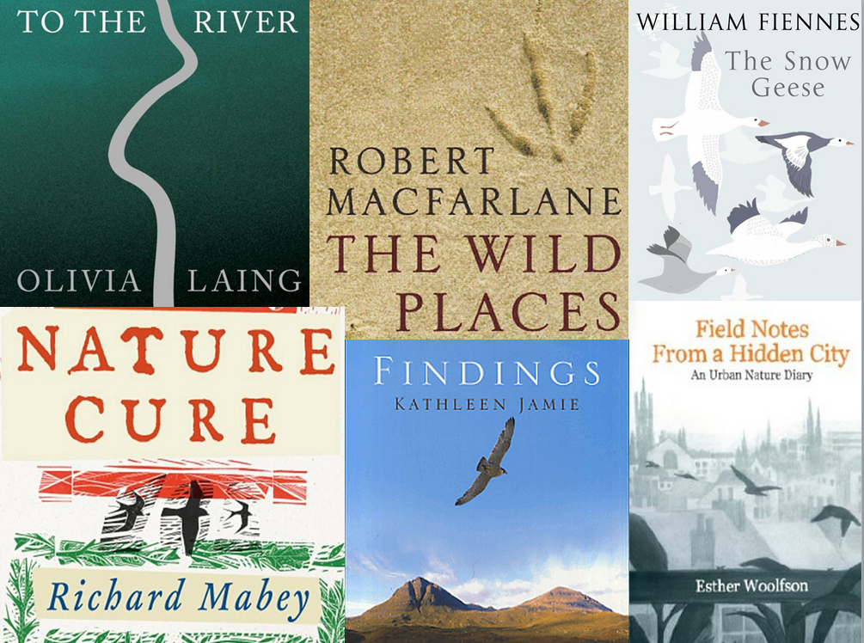
basic level
peregrines, ospreys, peewits, cranes, salmon, ravens, herons, gannets, corncrakes, minke whales, snow geese, bald eagles, Canada geese, grizzly bears, badgers, kites, rats, nightingales, magpies, beavers, whooper swans, otters, golden eagles, swifts, larks, hares, deer, and sparrows.
Notes:
There are different levels of abstraction that we can use. We can talk about otters, mammals, fauna, or biological resources. New Nature writing books frequently talk about animals at the ‘basic level’, which is the level that it is easiest to imagine them at. It’s far easier to get an image in our minds of an ‘otter’ than ‘fauna’.

Slide 13


sense image
Deer bounded along the stubble edge as geese returned to their roosts from grain fields: smudges and specks of geese above the low sun. (NW2:93)
He [a peregrine] flew in an easy loop, and when the sunlight glanced his undersides they were pale and banded like rippled sycamore (NW3:30)
Notes:
A sense image is where the author describes exactly what an observer would see, hear, smell, touch or taste rather than giving objective facts about what is there. So in the first example, Fiennes does say ‘there were geese in the fields’, he talks about ‘smudges and specks of geese above the low sun’, causing the reader to get a vivid image of the geese in their mind.

Slide 14
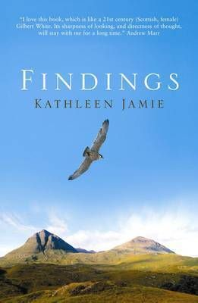
He [a peregrine] flew in an easy loop, and when the sunlight glanced his undersides they were pale and banded like rippled sycamore (NW3:30)
visual salience
Notes:
Finally, there is also visual salience. Kathleen Jamie gives a peregrine salience in her words using a sense image ‘He flew in an easy loop, and when the sunlight glanced his undersides they were pale and banded like rippled sycamore.’. The cover of the book reflects this perfectly, giving the peregrine salience through being in a central position, in the foreground, against plain background, and the only animal present.

Slide 15
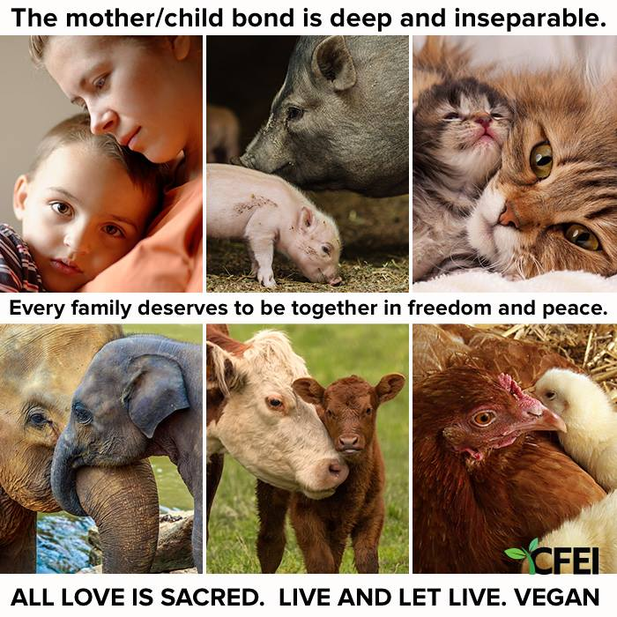
Notes:
Another example of visual salience is this poster from Compassionate Farming Education Initiative, an organisation which promotes plant-based farming as more sustainable and humane than meat or dairy production. In these pictures, the family members are depicted in high salience through firstly being represented in close up, with faces filling the frame. Secondly, through eyes looking out at the viewer, forming a ‘demand image’, i.e., an image which demands a relationship between the depicted subject and the viewer. Thirdly, by being represented in the foreground, and being unique individuals rather than part of an indistinguishable crowd. Clearly, the parallelism in the images echoes the word ‘every family’, showing that animals and humans have the same kind of bond between mother and child.

Slide 16
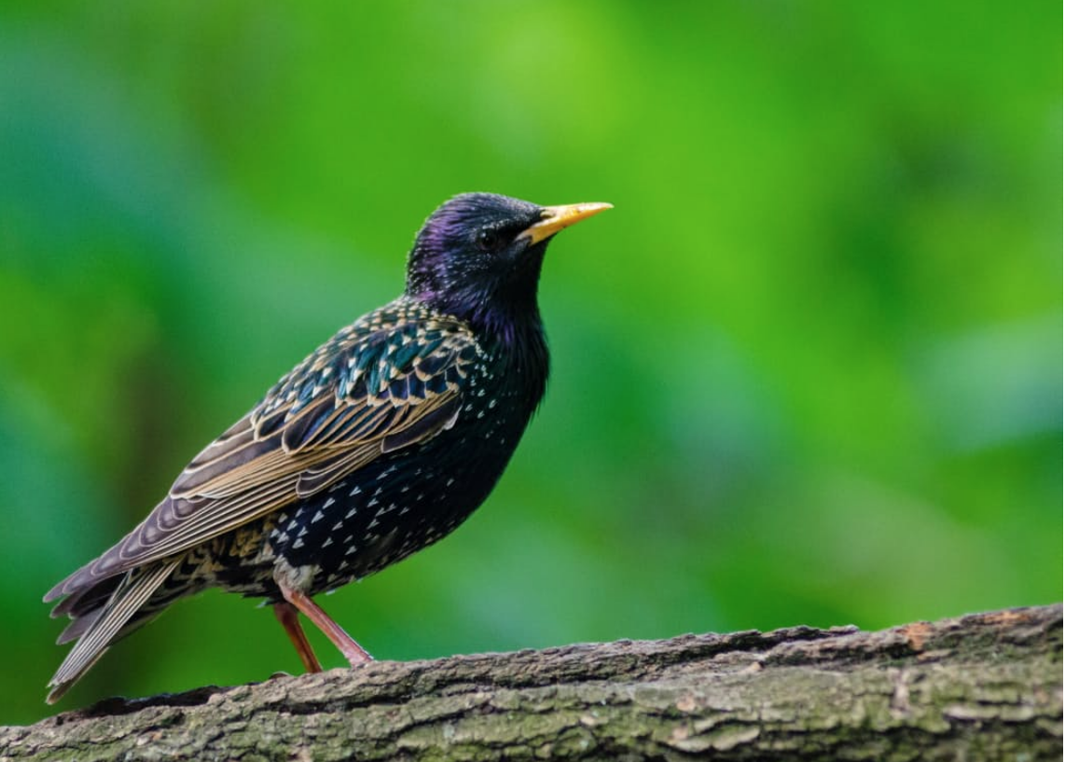
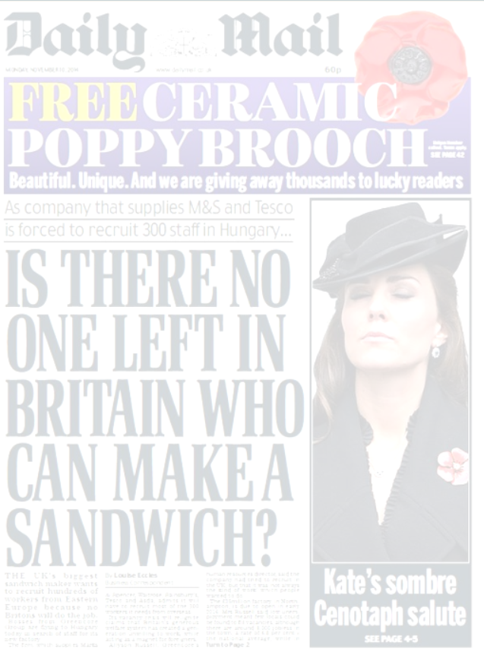
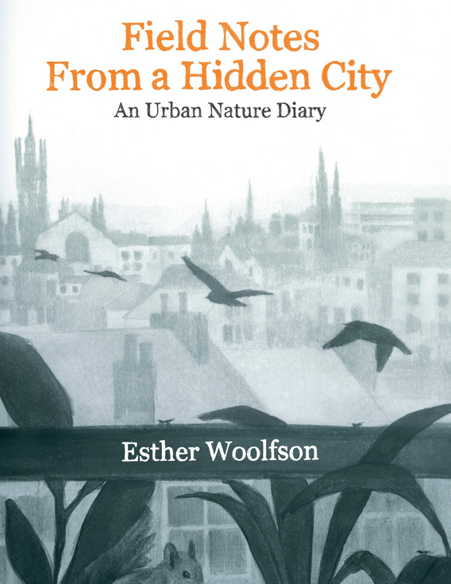
individualisation
EXAMPLE
A cul-de-sac is being drenched in bird droppings after it was invaded by a flock of more than 20,000 starlings. Like a scene from Alfred Hitchcock's thriller The Birds, the huge swarm turns the sky black each dawn and dusk as they prepare to feed or roost for the night (Daily Mail).
The starling I personally knew was Max…I think of the nature of his character, the exquisite sweetness of his evening solos as well as the extraordinary beauty of the bird, the gilded feathers, the neatness of wing as he flew…(NW7:55).
Notes:
This is an example of individualisation, about starlings. In the Daily Mail article the starlings are erased by the collective nouns ‘flock’ and ‘swarm’, and are made to seem negative through the connotations of drenched, invaded and swarm. On the other hand, in the New Nature Writing book ‘Field notes from a hidden city’, Esther Woolfson gives starlings very strong salience. She does this by talking about an individual and giving him name, ‘Max’. She then describes Max’s appearance in detail, creating a strong image in people’s minds of Max as a unique individual. And she uses words with positive connotations: exquisite, extraordinary, beauty, gilded, and neatness. In doing this she encourages us to notice the world beyond the human, and to care.

Slide 17
End of Part 9

Slide 18
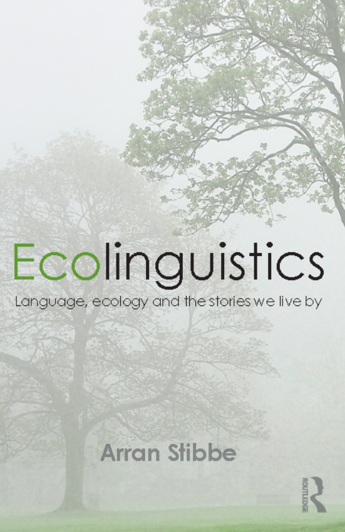
BASED ON
chapter 9 of
Stibbe, Arran (2015) Ecolinguistics: language, ecology and the stories we live by. London: Routledge

Slide 19
CREDITS
Produced by Arran Stibbe, with the assistance of:
Charlotte Dover
Alex James
Meg Shaw
Nicole Walker
and other volunteers from the International Ecolinguistics Association and the University of Gloucestershire.
Filming by Unit One Films, http://unit1films.co.uk

Slide 20
COPYRIGHT
These materials have been produced for public benefit and the producer places no restriction on their subsequent re-use for any purpose. However, copyright of images and quotations used in these materials remains with the original producers.

Slide 21
IMAGES
Head cogs | Copyright: Krisdog / 123RF Stock Photo (www.123rf.com/profile_Krisdog)
World | Copyright: robertsrob / 123RF Stock Photo (www.123rf.com/profile_robertsrob)
Society | Copyright: eobrazy / 123RF Stock Photo (www.123rf.com/profile_eobrazy)
Nature person | Copyright: lenanet / 123RF Stock Photo (www.123rf.com/profile_lenanet)
Valley, ladybird and woods | Pixabay (www.pixabay.com)
Starling | Pexels (www.pexels.com)

Slide 22
REFERENCES
General
Chief Dan George http://www.whitewolfpack.com/2015/09/feed-your-spirit-19-words-of-wisdom-by.html
Leopold, A., 1979. A sand county almanac and sketches here and there. Oxford University Press. p.214
Mankiw, G., 2011. Principles of Microeconomics (6th edition). Nashville: South-Western.

Slide 23
REFERENCES
New Nature Writing Books
NW1 | Crumley, J., 2007. Brother nature. Dunbeath: Whittles Publishing.
NW2 | Fiennes, W., 2003. The snow geese. London: Picador.
NW3 | Jamie, K., 2005. Findings. London: Sort of Books.
NW4 | Laing, O., 2011. To the river: a journey beneath the surface. Edinburgh: Canongate Books.
NW5 | Mabey, R., 2006. Nature cure. London: Pimlico.
NW6 | Macfarlane, R., 2009. The wild places. London: Granta Books.
NW7 | Woolfson, E., 2013. Field notes from a hidden city: an urban nature diary. London: Granta Books.

Slide 24
OTHER IMAGES AND QUOTATIONS
Any quotations and images not mentioned above are reproduced as fair dealing under Section 29(1), Section 30(1) and 30A of the UK 1988 Copyright, Designs and Patents Act, for non-commercial purposes of instruction, review, criticism, parody or pastiche.
Requests for removals of any materials to astibbe@glos.ac.uk

