Slide 1
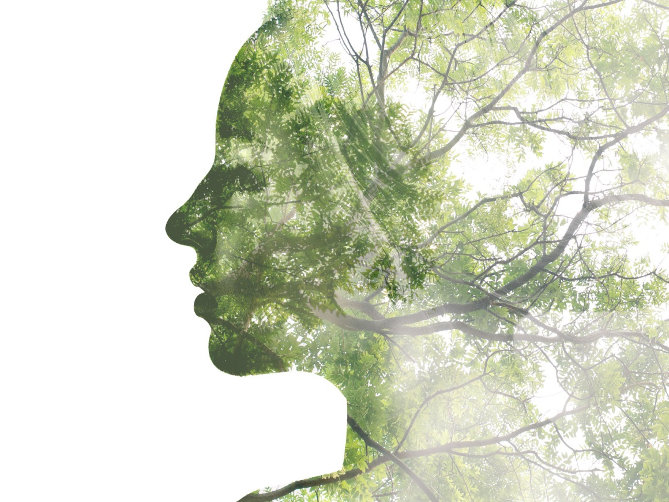
The Stories We Live By
A free online course in ecolinguistics
www.storiesweliveby.org.uk
by Arran Stibbe
University of Gloucestershire

Slide 2
Part 6: Identities
Notes:
Welcome to part 6 of the course The Stories We Live By. In this part we will be looking at identities

Slide 3
Social Cognition |  | Linguistic Manifestation
Type | Explanation | What to look for
ideology | a story of how the world is and should be which is shared by members of a group | discourses, i.e., clusters of linguistic features characteristically used by the group
framing | a story that uses a packet of knowledge about an area of life (a frame) to structure another area of life | trigger words which bring a frame to mind
metaphor (a type of framing) | a story that uses a frame to structure a distinct and clearly different area of life | trigger words which bring a specific and distinct frame to mind
evaluation | a story about whether an area of life is good or bad | appraisal patterns, i.e., patterns of language which represent an area of life positively or negatively
identity | a story about what it means to be a particular kind of person | forms of language which define the characteristics of certain kinds of people
conviction | a story about whether a particular description of the world is true, uncertain or false | facticity patterns, i.e., patterns of linguistic features which represent descriptions of the world as true, uncertain or false
erasure | a story that an area of life is unimportant or unworthy of consideration | patterns of language which fail to represent a particular area of life at all, or which background or distort it
salience | a story that an area of life is important and worthy of consideration | patterns of language which give prominence to an area of life
Notes:
which are the fifth type of stories that we live by.

Slide 4
Identities
stories about what it means to be a particular kind of person
Notes:
Identities are stories in people’s minds about what it means to be a particular kind of person

Slide 5
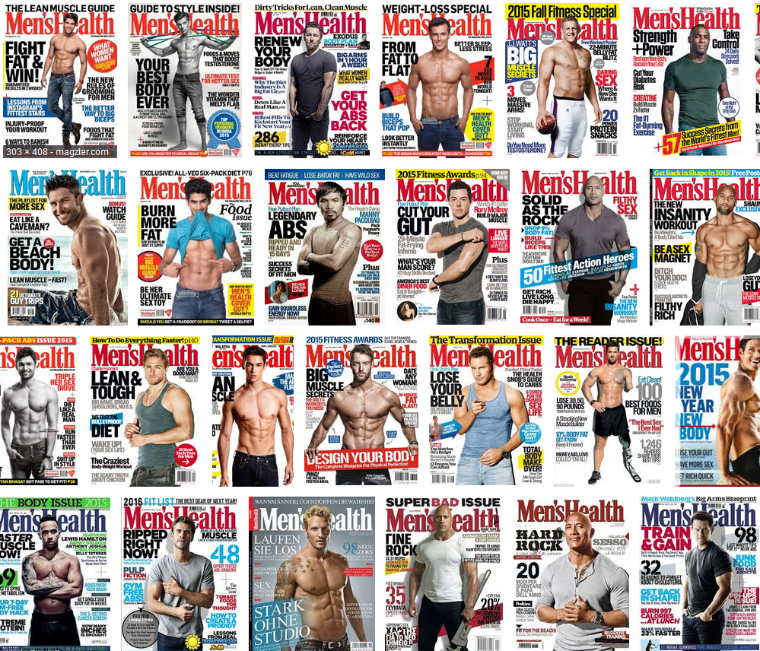
MEN’S HEALTH MAGAZINE
Notes:
We’ll start with the example of Men’s Health Magazine which like any men’s lifestyle magazine tells stories about what it means to be an ideal man.

Slide 6
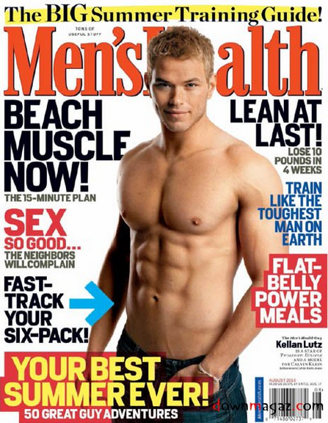
Magazine covers are a ‘Window to the future self’ (McCracken 1993, p. 13)
Men’s Health (UK) cover August 2014
Notes:
The stories can be seen clearly on the cover, where muscular semi-naked men look out at the reader. But this isn’t just any man, this is the future you, if you follow the advice of the magazine. As McCracken puts it, the cover is a ‘window to the future self’. The cover has short noun phrases like ‘Beach Muscle’ and imperatives ‘Train like the toughest man on earth’. And by appearing on the cover of a lifestyle magazine these short phrases presuppose their own desirability. By investigating these phrases we can discover what stories the magazine tells about the ideal man.

Slide 7
Magazine covers are a ‘Window to the future self’ (McCracken 1993, p. 13)
BUILD BIG ARMS (MH4: cover).
BUILD 6KG OF HARD MUSCLE (MH3: cover).
6-PACK ABS (MH2: cover).
20% More Muscle (MH2: cover).
MUSCLE POWER SPEED! (MH3: cover).
MUSCLE DOUBLED! (And Body Fat Halved) (MH5: cover).
BUILD ARMS LIKE THIS - 6 moves to add 3in by April (MH1: cover).
HARD ABS (MH6: cover).
PACK ON 10KG OF MUSCLE (MH7: cover).
Men’s Health (UK) cover August 2014
Notes:
One of the main stories, of course, is that the ideal man has enormous muscles. This may make the average reader feel inadequate and encourage them to buy the enormous powerful cars that the magazine advertises to compensate. But there is another environmental aspect to huge muscles.

Slide 8
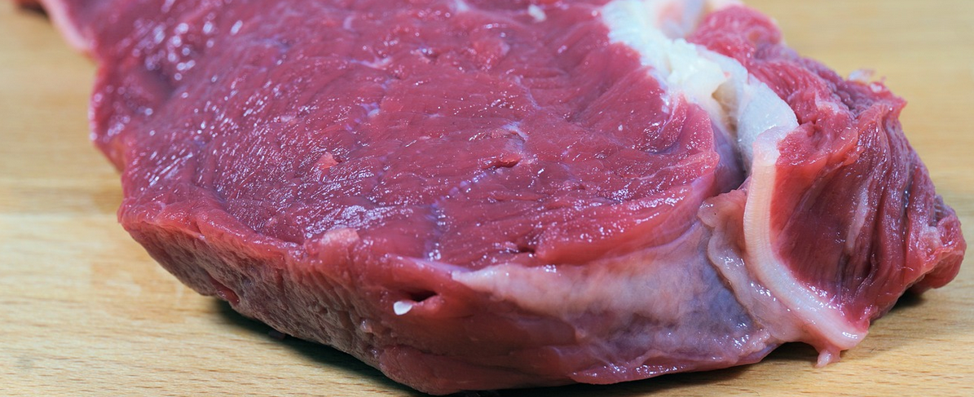
I eat a lot of meat. I’m not boasting… I need the protein for muscular growth…I eat animal protein at every meal (MH7:137).
Sweet science of beefing up. Steak is a reliable weapon in the battle to bulk up, with protein and creatine arming your muscular growth when training (MH4:114).
MEN’S HEALTH MAGAZINE
Notes:
Another story that the magazine tells is that the Ideal man is an meat eater, not just that but a red meat eater. Over and over again the magazine connects mean with muscle with manliness. This first example, ‘I eat a lot of meat. I’m not boasting’ presupposes that eating a lot of meat is the kind of thing that men are proud of. The second example is a war metaphor, where meat is represented as a weapon in a battle.

Slide 9
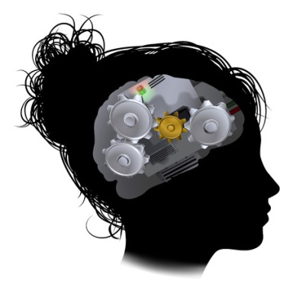
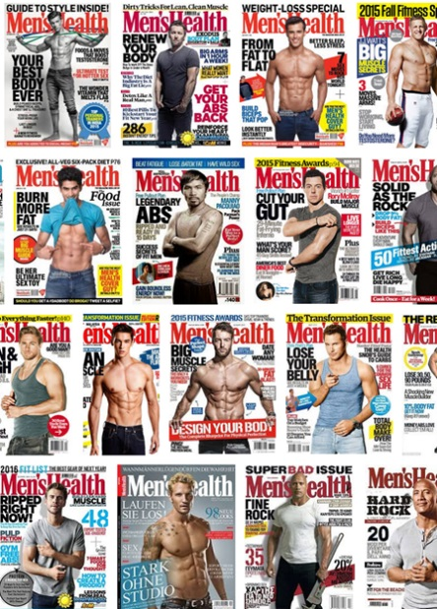

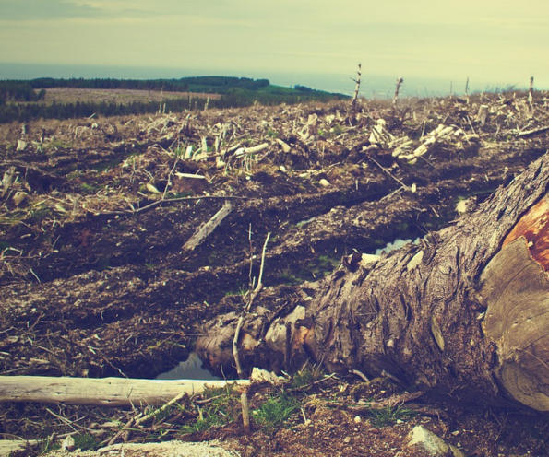

Stories influence how we:
THINK TALK and ACT
Identities
Language and Images
Impact
the ideal man has huge muscles
the ideal man eats lots of meat
Notes:
Taken together, the language and images in the magazine tell the story that the ideal man eats a lot of meat to grow huge muscles. If stories influence how we think, talk and act, then this one can encourage men to eat large quantities of meat. Animal farming is, of course, one of the leading contributors to climate change, is highly inefficient in terms of resources, polluting and cruel to animals. We can say that the identity of the big muscled big meat eater is a destructive story.

Slide 10





MEN’S HEALTH MAGAZINE
use explosive power like a norman knight…Norman knights used the high protein content of their meat to build the explosive power required for successful Saxon smashing (MH7:30).
Notes:
There’s another story that runs through men’s health magazine – that the ideal man is violent and highly competitive.

Slide 11
the ideal man is competitive
working out on his own to gain
power, status, muscle, performance
not
actions which benefit the world
Notes:
The ideal man works out on his own to gain power, status, muscle, and improve his performance so that he can compete and beat other men. But just think about all that energy and effort being wasted when it could go into actions which benefit the world. There’d be no more environmental problems if we turned all that man power into positive actions. But there is one exception, where men are portrayed as connecting with other people rather than being isolated, and that is…

Slide 12
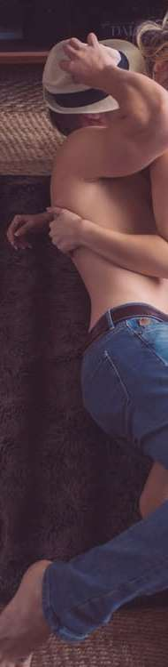
The one exception, where men are portrayed as connecting with others is:
SEX
bulk up, slim down…with sex…The coregasm: lie back and think of muscle… (MH3:77)
The dirty weekend that burns 10,000 calories’ (MH4: cover).
MEN’S HEALTH MAGAZINE
Notes:
Except that the magazine manages to turn even the intimacy of sex into another opportunity to work out!

Slide 13
Ecological Identities
Identities where humans are considered to be part of a group which includes non-humans
Notes:
We could look at endless examples of texts which build negative consumer identities, but ecolinguistics also aims to search for positive stories, positive identities. There are texts which convey ecological identities, where humans are seen to part of nature rather than separate and superior to it. I’ll give a few examples of how texts can construct ecological identities.

Slide 14
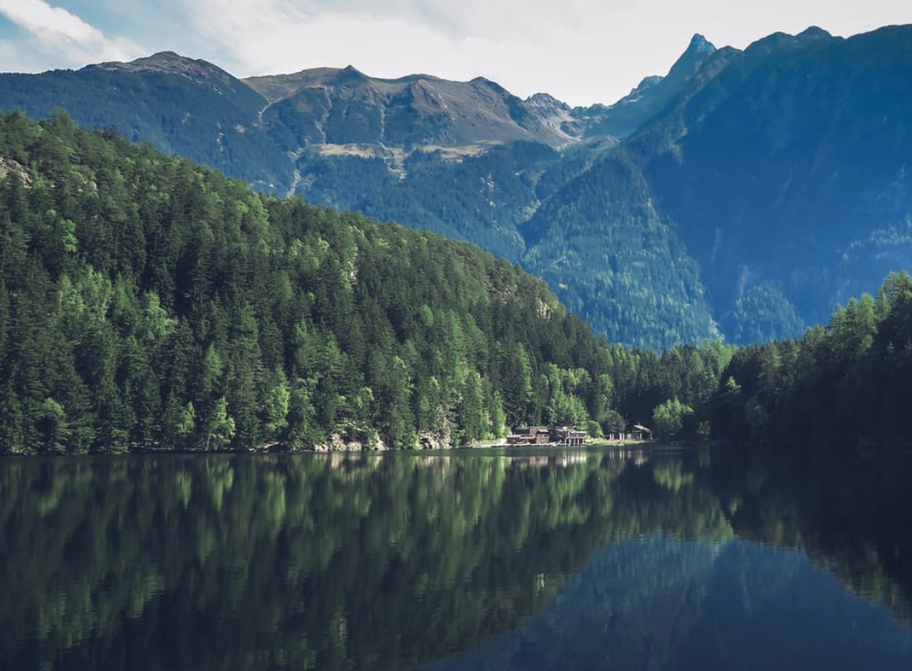
ALDO LEOPOLD
Re-framing
We abuse land because we regard it as a commodity. When we see land as a community to which we belong we may begin to use it with love and respect.
Notes:
In this example, Aldo Leopold is reframing land from being a commodity to a community, and then placing humans within the community rather than outside of it.

Slide 15
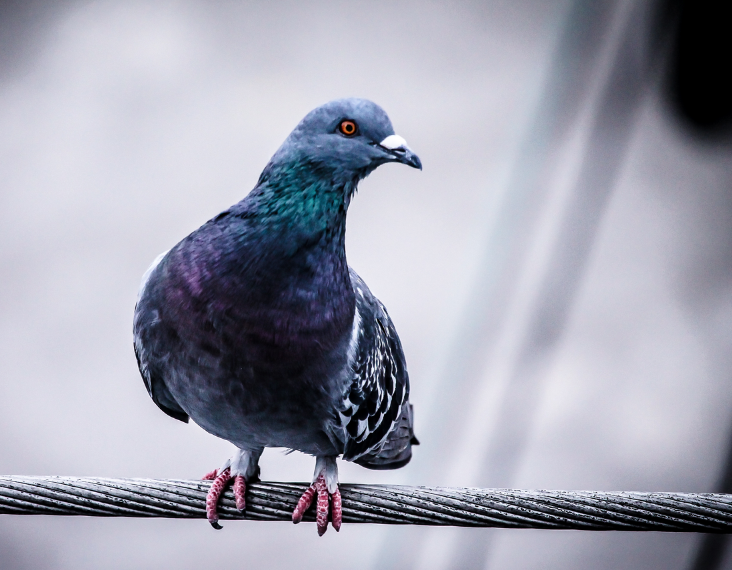
ESTER WOOLFENSON
Pronoun use
Pronoun use
Together, in spite of our obvious differences, we were as bound as any two creatures on earth by something only too measurable – life itself
Notes:
Here, Ester Woolfenson is talking about a wounded pigeon she was looking after, and using the word ‘our’ to include both herself and the pigeon. This places humans and pigeon into the same category, sharing the same word and world.

Slide 16
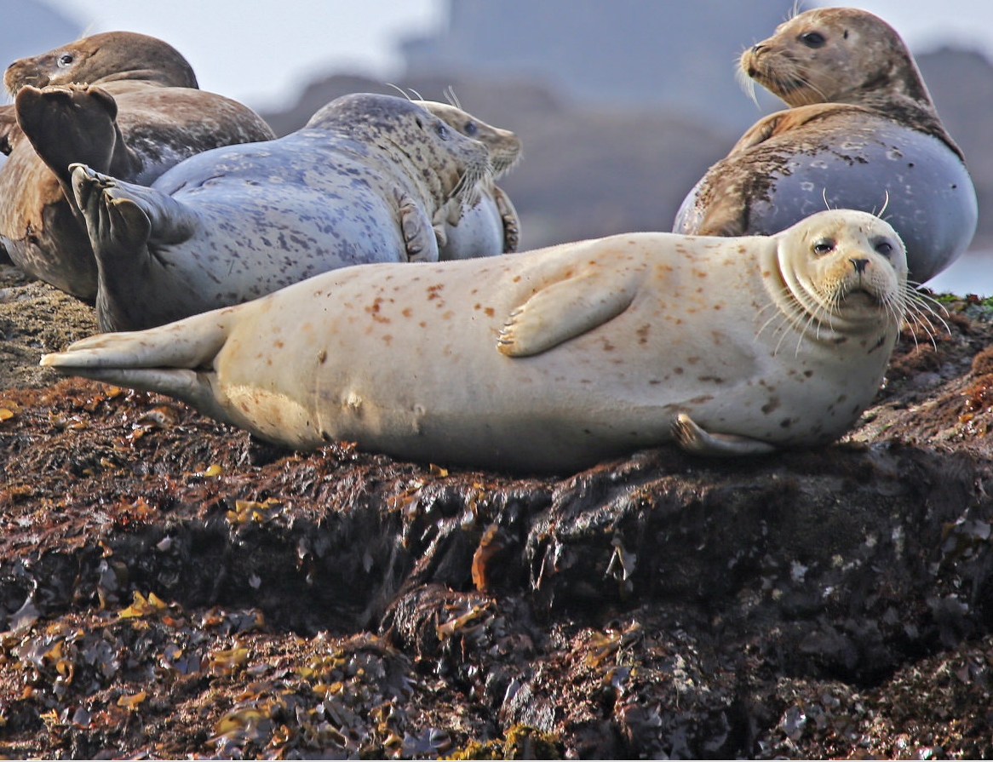
ROBERT MACFARLANE
Two big seals…slipped into the water, rolled onto their backs, and sculled past the mouth of the gulch, gazing at me. They both dived…For ten seconds or so we stared at each other.
Reciprocal pronoun
Shared role as senser of same mental process
Notes:
In this example, Robert Macfarlane says ‘we stared at each other’, which not only places seals within the same pronoun ‘we’, but also places human and seal as the subjects of the same verb, of staring. It also uses the reciprocal pronoun ‘each other’, applying to humans and non-humans. In this way, the texts place humans into the same category as non-humans and construct ecological identities. If we are part of the natural world then, perhaps, we would be less likely to destroy it.

Slide 17
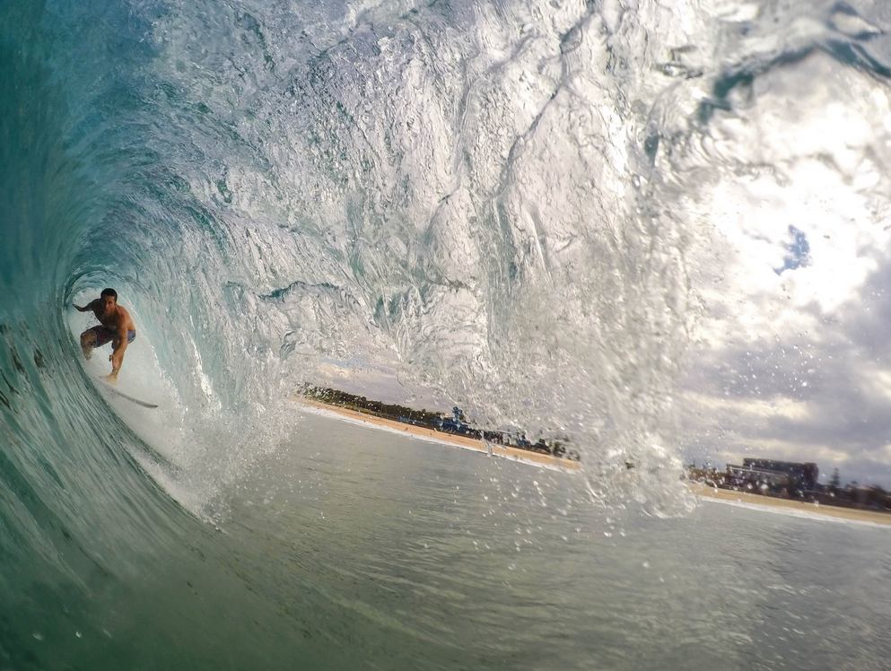
EXAMPLE
SURFERS AGAINST SEWAGE
SUSTAINABLE GUIDE TO SURFING
As surfers, we are interested in being able to continue to surf, and for our children and grandchildren to be able to surf (p.8).
surfers…were already living closer to nature (p.3).
as surfers we are sensitised incrementally to the environment around us and the damage done to it (p.6).
Notes:
The last example comes from a guide by the environmental surfing organisation ‘Surfers Against Sewage’. Surfing can be quite a consumerist pastime, with advertisers keen to build up the identity of a fashion-conscious surfer who is always buying the latest accessories and brands. But Surfers Against Sewage counter this by building an environmental identity for surfers. Linguistically, the way they do this is through the expression ‘As surfers’, which expresses with high modality (certainty) what surfers are interested in and what they care about. It also uses the pronoun ‘we’, to include the reader and the writer into the same group. This is very clever since it isn’t pointing fingers and saying what the reader is doing wrong, but including them in a group of people who are doing things right.

Slide 18
End of Part 6

Slide 19
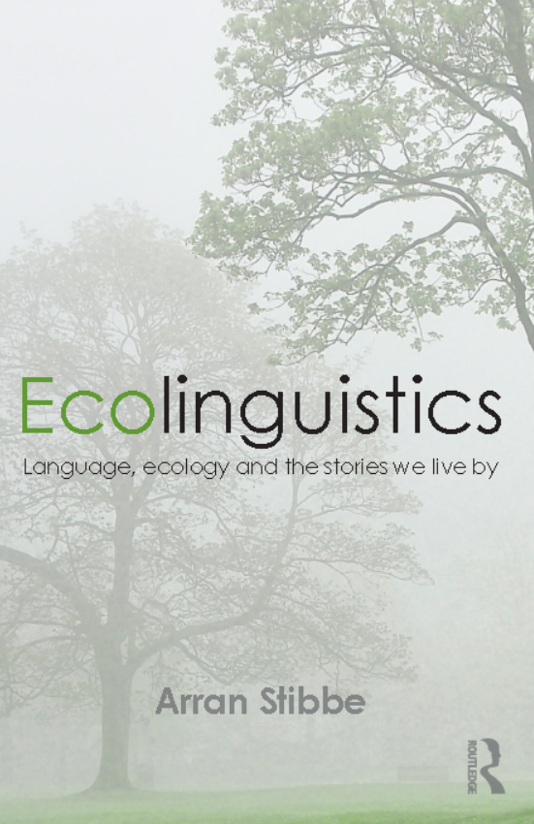
BASED ON
chapter 6 of
Stibbe, Arran (2015) Ecolinguistics: language, ecology and the stories we live by. London: Routledge

Slide 20
CREDITS
Produced by Arran Stibbe, with the assistance of:
Charlotte Dover
Alex James
Meg Shaw
Nicole Walker
and other volunteers from the International Ecolinguistics Association and the University of Gloucestershire.
Filming by Unit One Films, http://unit1films.co.uk

Slide 21
COPYRIGHT
These materials have been produced for public benefit and the producer places no restriction on their subsequent re-use for any purpose. However, copyright of images and quotations used in these materials remains with the original producers.

Slide 22
IMAGES
Head cogs | Copyright: Krisdog / 123RF Stock Photo (www.123rf.com/profile_Krisdog)
World | Copyright: robertsrob / 123RF Stock Photo (www.123rf.com/profile_robertsrob)
Society | Copyright: eobrazy / 123RF Stock Photo (www.123rf.com/profile_eobrazy)
Nature person | Copyright: lenanet / 123RF Stock Photo (www.123rf.com/profile_lenanet)
Steak, deforestation and couple | Pixabay (www.pixabay.com)
Landscape, pigeon, seals, surfing | Pexels (www.pexels.com)

Slide 23
IMAGES
Cover of Men’s Health magazine, August 2014, reproduced under fair dealing legislation for the purpose of academic criticism.
Montage of Men’s Health covers reproduced under fair dealing legislation as pastiche and for academic criticism (for purpose of demonstrating pattern across covers)

Slide 24
REFERENCES
Leopold, A., 1979. A sand county almanac and sketches here and there. Oxford University Press. p.viii
Macfarlane, R., 2009. The wild places. London: Granta Books. p.34
MH1 2013. Men’s Health. UK edition. March.
MH2 2013. Men’s Health. UK edition. Jan/Feb.
MH3 2012. Men’s Health. UK edition. Dec.
MH4 2012. Men’s Health. UK edition. Nov.
MH5 2012. Men’s Health. UK edition. July.
MH6 2012. Men’s Health. UK edition. October.
MH7 2012. Men’s Health. UK edition. Jan/Feb.
Surfers Against Sewage, 2014. Sustainable guide to surfing. www.sas.org.uk/news/campaigns/sass-sustainable-guide-to-surfing/
Woolfson, E., 2013. Field notes from a hidden city: an urban nature diary. London: Granta Books. p.8

Slide 25
OTHER IMAGES AND QUOTATIONS
Any quotations and images not mentioned above are reproduced as fair dealing under Section 29(1), Section 30(1) and 30A of the UK 1988 Copyright, Designs and Patents Act, for non-commercial purposes of instruction, review, criticism, parody or pastiche.
Requests for removals of any materials to astibbe@glos.ac.uk

